Slide 1
Name : Patel Om Jigneshkumar
Course : Soft Skills (Node JS)
Faculty : Disha Ma’am

Slide 2
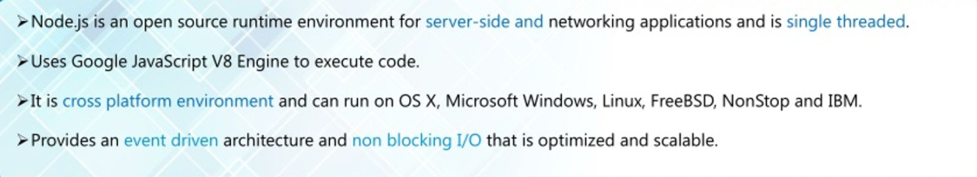
Introduction to Node.js

Slide 3

Why I Chose Node.js
Main Reason for selecting Node js Backend course
Since Node JS is fundamentally based on Javascript, which works for both frontend and backend.
Hence , I will stand a chance to work as a full stack developer in future by learning frontend languages such as React.
It will also provide me advantage in learning Next Js.

Slide 4

Features of Node JS

Slide 5
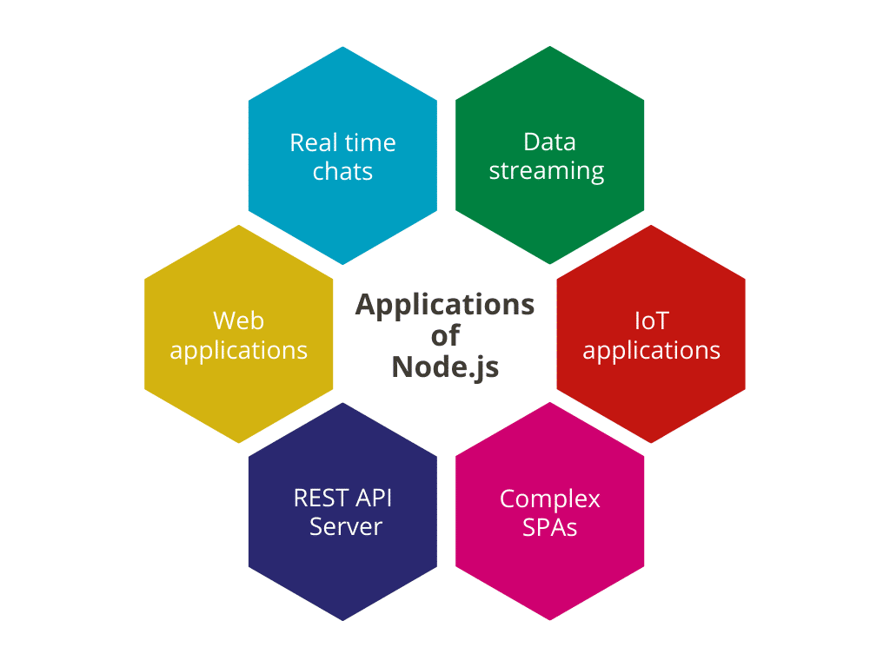
Applications of Node JS

Slide 6

Real life Usage of Node JS by big companies

Slide 7


